Slide 1
April Highlights
April is Financial Literacy Month!
Find timely resources for all grade levels in each of these channels. Sign in to DE and select the link to explore.
Financial Literacy Channel (K-12)
Pathway to Financial Success (6-12)
Discover Venture Valley (6-12)
Econ Essentials (9-12)
Timely Celebrations
National Poetry Month – Pump up your literature lessons and learn about groundbreaking poets with this collection of resources, sorted by grade band.
World Health Day (4/7) – Ensure your students are equipped with the knowledge and resources to be healthy for their future.
International Day of Human Space Flight (4/12) – Expand your perspective from Earth, to the solar system, and to the edges of space.
Earth Day (4/22) – Celebrate Earth Day with this collection of engaging activities that students, educators, and families can do to invest in our future and make a meaningful difference for our planet.
Shakespeare Day (4/23) – Explore Shakespeare's finest works and discover why his plays continue to be rediscovered, adapted, and performed by diverse cultures throughout the world.
Holocaust Remembrance Day (Yom HaShoah) (4/23-4/24) – Honor survivors and witnesses of the Holocaust and other genocides with audio-visual interviews sharing a compelling voice for education and action.
Check out our This Month at DE: April blog for new content, timely resources, and events to celebrate all month long!

Slide 2
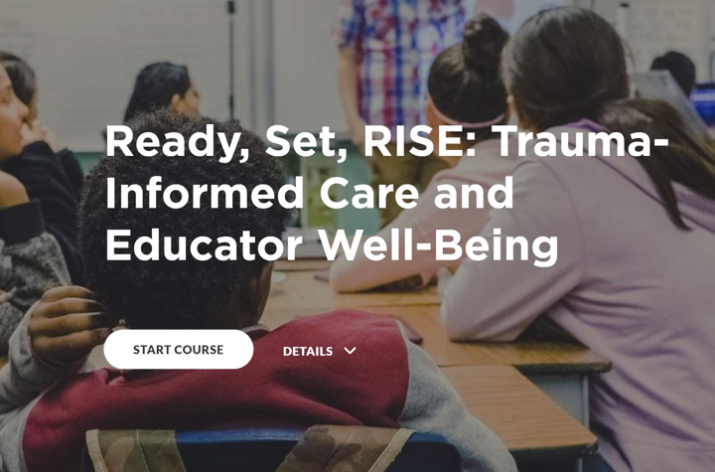
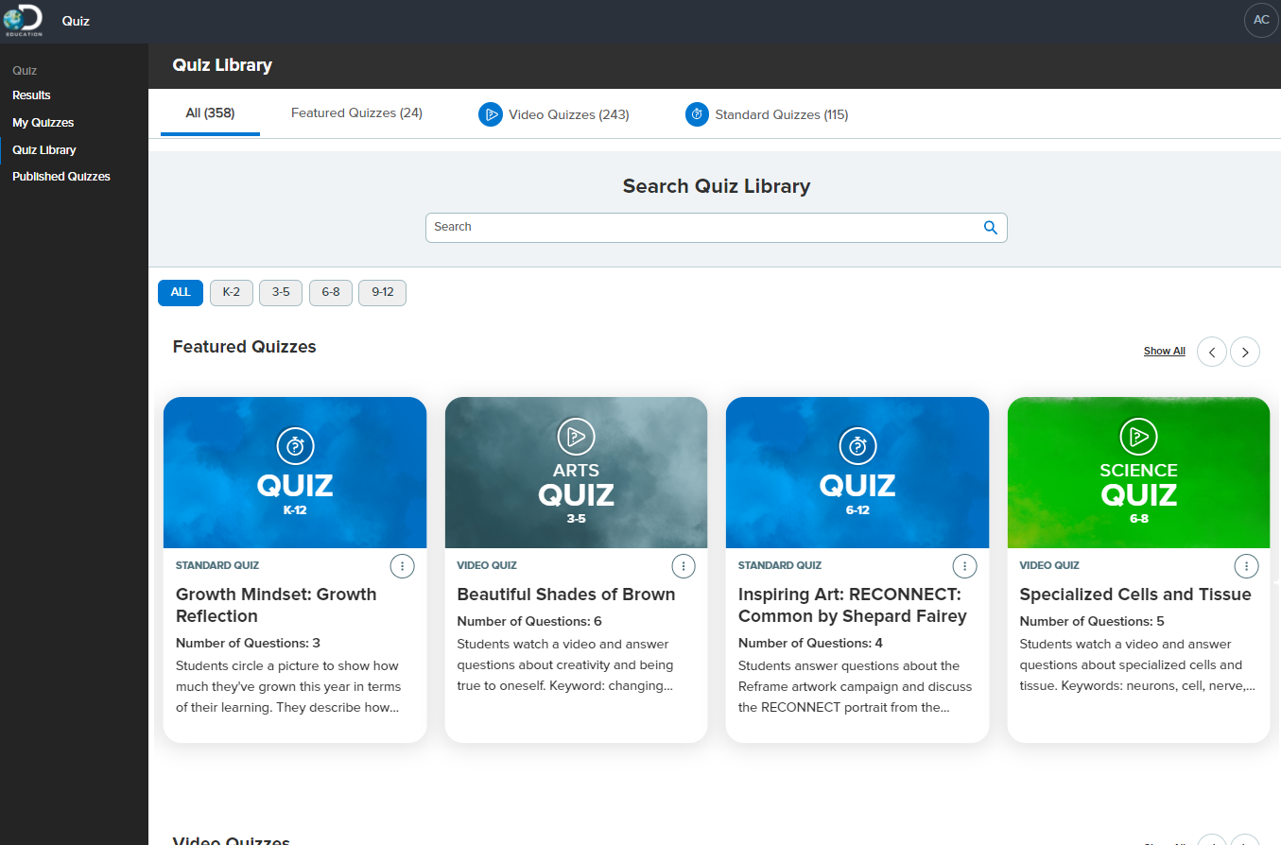
April Highlights
Ready-To-Use Activities
Explore ready-to-use activities to use this month that provide students with opportunities to explore their curiosity around a variety of topics in our Instructional Activities Channel.
PL Resource of the Month: Ready, Set, RISE: Trauma-Informed Care and Educator Well-Being
This module will provide clarity of the intended goals and outcomes of trauma-informed care to best equip educators to apply positive strategies when working with students with ACEs. Find more modules like this in the Ready, Set, RISE channel.
Strategy of the Month: Eye Spy
Students are scaffolded through an analysis of an image, helping the, see details that they might otherwise miss. View all strategies in the SOS Channel.
Feature of the Month: Quiz Library
Available within Quiz, teachers can search, find, and utilize over 300+ premade quizzes spanning various subjects and grade levels. Quiz Library contains subject-specific, assessment-style quizzes as well as morning-meeting style activities and conversation starters to suit all classroom needs.
Check out our This Month at DE: April blog for new content, timely resources, and events to celebrate all month long!

Slide 3
April Highlights
Elementary: PreK – 2 Recommended Resources
Literacy: Earth to Luna – Follows Luna, her brother Jupiter, and pet ferret Clyde on real-life and imaginary adventures to explore life, physical, and earth and space science concepts. This channel is also available in Spanish.
Math: Money – Explore this collection of resources to help students discover the important roles of money.
Science: Seasonal Change – Discover a collection of videos, images, songs, and writing prompts that explore the science behind the seasons and their environmental effects.
Social Studies: Goods and Services – Dive into economic concepts by examining the roles of goods and services in a community.
Health & Wellness: Everyday Speech – Explore this collection of videos, activities, and worksheets that guide younger students to harness their own identity and develop healthy relationships with others.
Elementary: 3 – 5 Recommended Resources
Literacy: WordGirl – Follow the adventures of WordGirl as she fights off evil villains with superhuman powers and learns new vocabulary words every day. This channel is also available in Spanish.
Math: Units of Measurement – Help students employ the appropriate tools and units to measure distance, weight, volume, and more with this collection of resources.
Science: DEmystified – Join Discovery Education on our endless journey to DEmystify the wonders of our world—you might just be surprised by what you find.
Social Studies: Liberty's Kids – Travel back in time to witness and discover the birth of democracy in America through the eyes of James and Sarah, two teenage apprentices who worked in Benjamin Franklin's print shop..
Health & Wellness: LaGolda SEL Resources by United Healthcare – By exploring important and potentially complex topics through the inviting animated community of LaGolda, students are able to stay open-minded, comfortable, and connected as they develop critical SEL concepts and skills.
Check out our This Month at DE: April blog for new content, timely resources, and events to celebrate all month long!

Slide 4
April Highlights
Secondary: 6 – 8 Recommended Resources
Literacy: Podcasts – Podcasts help build students' listening comprehension skills and offer a unique, on-the-go way to consume content. The series in this collection focus on topics ranging from science to technology to history to art and more.
Math: Standard Deviants Teaching Systems – Join the Standard Deviants as they teach lessons using their fun, fast-paced, and (sometimes) crazy style.
Science: PhET Interactive Simulations – Explore the electrifying world of molecular interactions, genetic mutations, planetary gravity, and more with these interactive simulations.
Social Studies: Encyclopedia Womannica – Encyclopedia Womannica, a podcast series from Wonder Media Network, offers bite-sized audio biographies of women you may or may not know, but whose impact has changed the world.
Health & Wellness: Generation Health by AstraZeneca & Learning Undefeated – This middle school program provides hands-on, standards-aligned STEM learning activities where students investigate both preventative measures and innovative solutions to key health concerns.
Secondary: 9 – 12 Recommended Resources
Literacy: The Golden Threshold – Explore this beautiful collection of poems published in 1905 by the famed "Nightingale of India," Sarojini Naidu.
Math: Econ Essentials by Future Fundamentals – Econ Essentials is a growing collection of interactive resources that introduce high school students to vital economics and financial principals through the lens of futures, brought to life by the industry-leading insights of Futures Fundamentals.
Science: NBA and WNBA in the Classroom: A Winning Combination – Get a scouting report on exciting STEM careers in basketball, explore how players and coaches are making an impact on the world around them, learn about basketball's rich history, and how the modern game relies on physics, geometry, and more!
Social Studies: Government – Break down government in the United States and the role that government plays in citizens’ lives.
Health & Wellness: Nutrition – Discover the science of nutrition with this collection of resources for students.
Check out our This Month at DE: April blog for new content, timely resources, and events to celebrate all month long!

