Slide 1
Class of 2025 Wolfpack

Slide 2
Apply to Colleges Universities Military Academies
Applications
Common App
Apply Texas
School Apps.
Essays
Extracurricular
Activities
Send SAT/ACT Scores - must come directly from the testing center
College
&
Career
Readiness Platform

Slide 3
Collegeboard: SAT FEE WAIVERS
NEW THIS YEAR!!! NEW THIS YEAR!!!
Eligible students are encourage to request a SAT fee waiver directly from CollegeBoard. To get your free fee waiver, complete an application by visiting https://satfeewaiverform.collegeboard.org/
Need Help?
Students can still visit the counseling center to request a SAT fee waiver code.

Slide 4
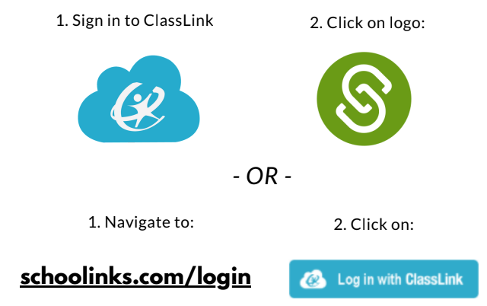
How to log in

Slide 6
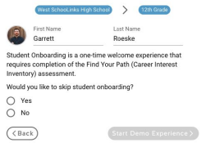
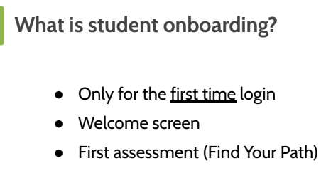
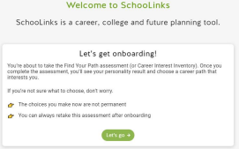

Slide 7
Transcripts
in
SchooLinks
Official for
NCAA & Scholarships
unofficial/copy

Slide 8
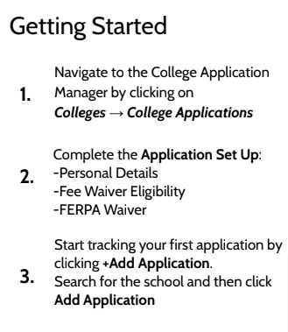
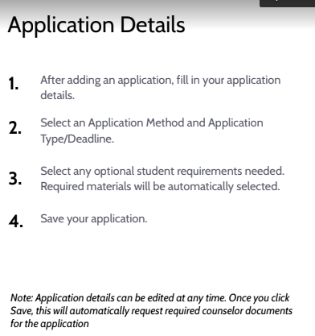
overview
X
Counselor Documents: Transcript,
Secondary School Report, School Profile

Slide 9
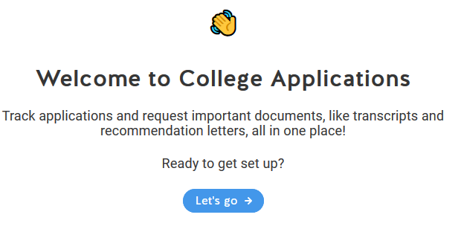
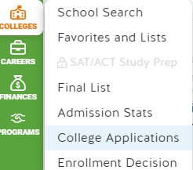

Slide 10
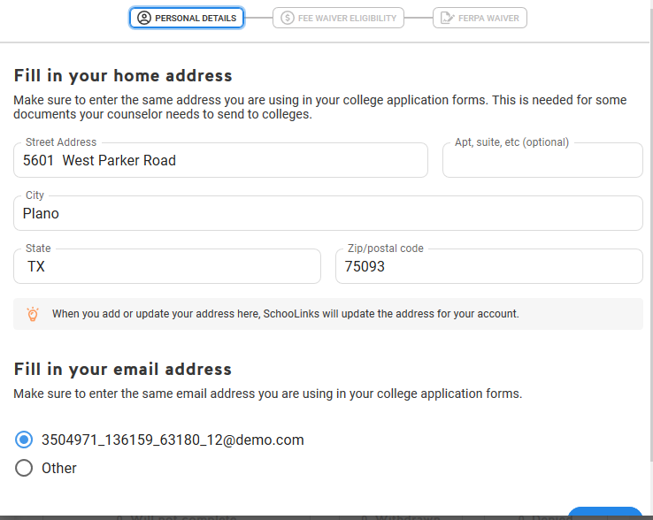

Slide 12
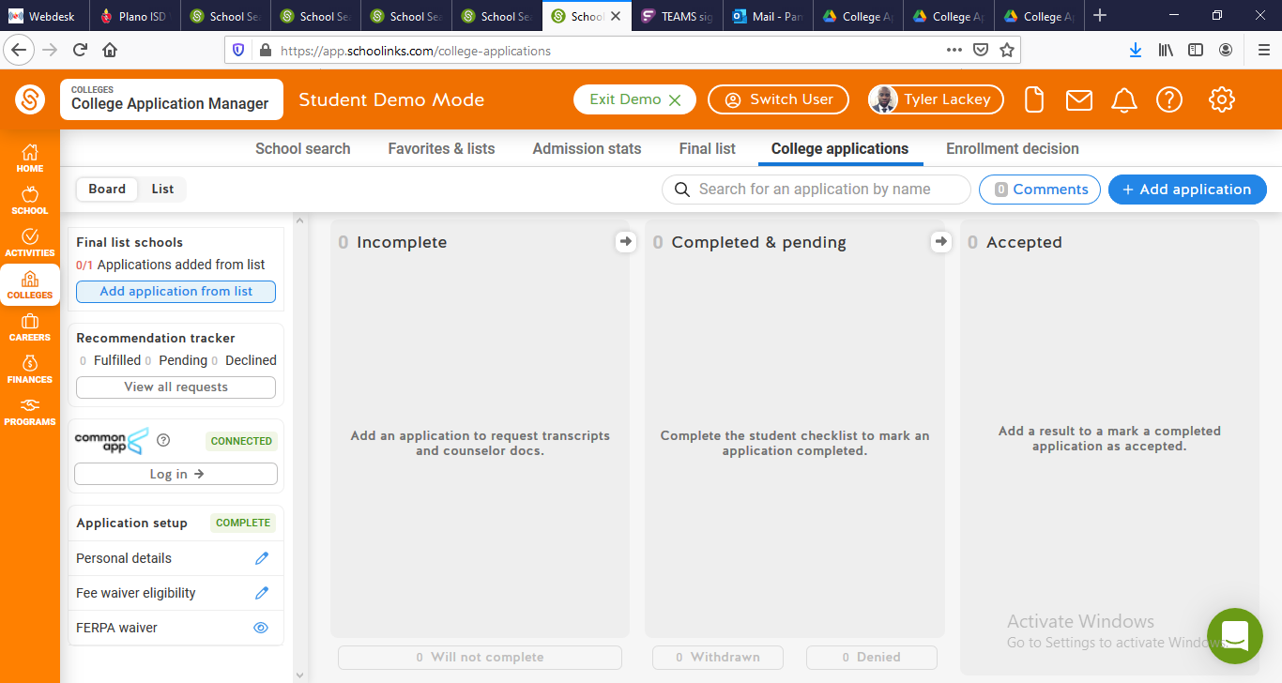
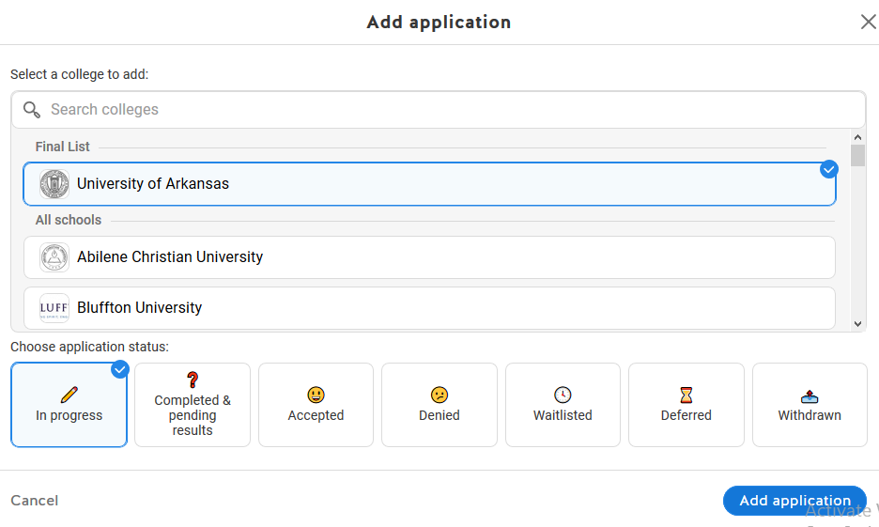

Slide 13
X

Slide 14
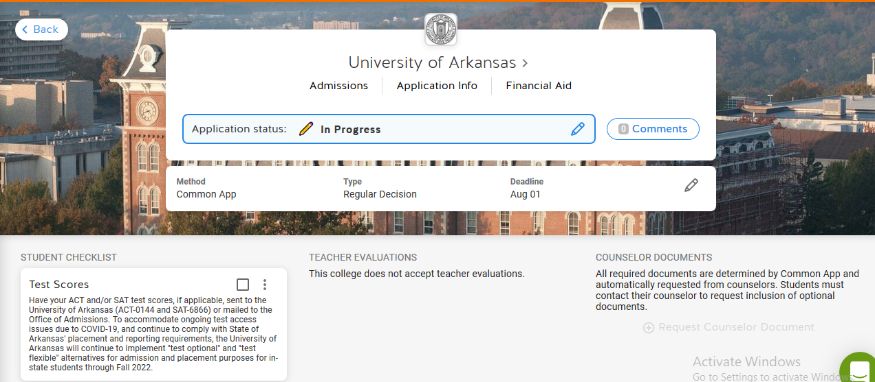
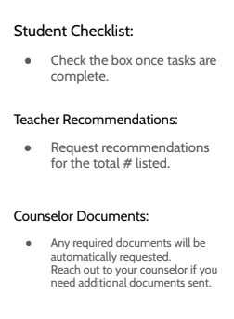
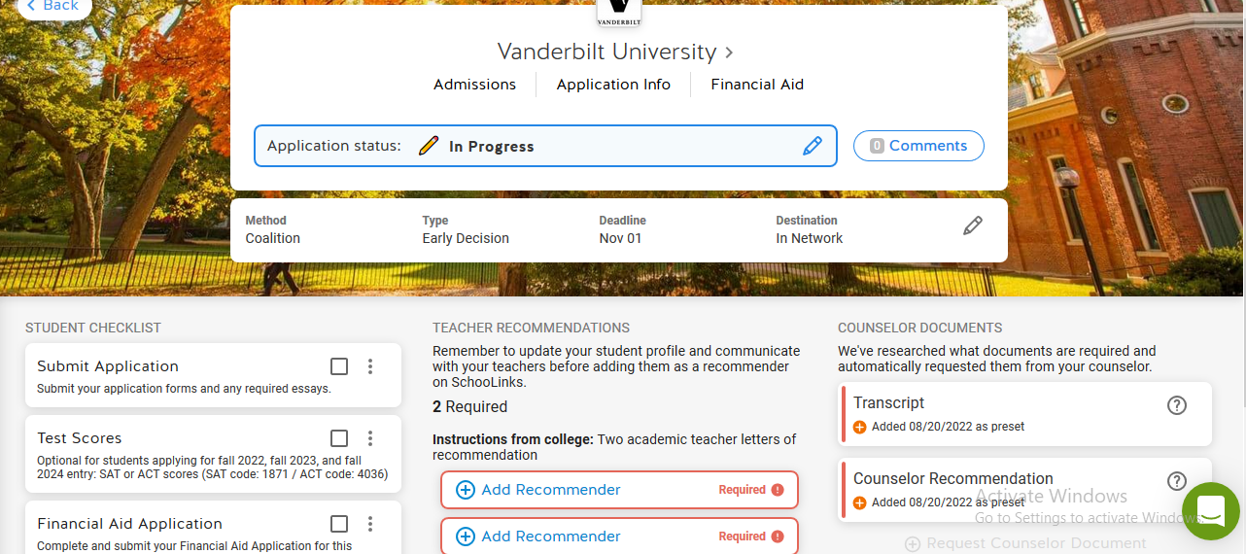

Slide 15
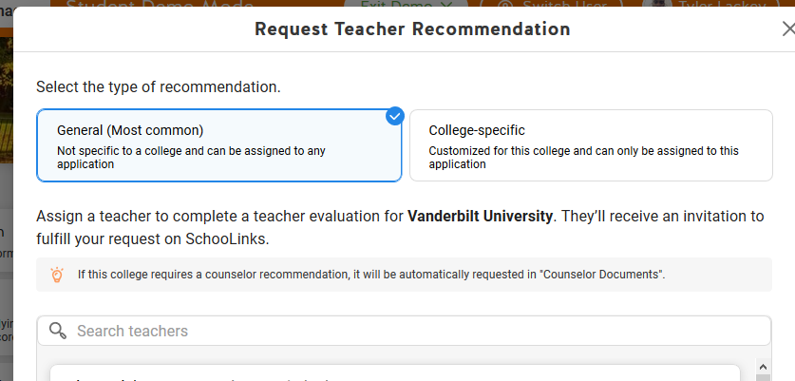
Request
Teacher
Recommendation
The teacher is alerted via email of the request.
Complete the Counselor Recommendation Packet
http://www.pisd.edu/domain/2498
Select your teacher….
Do not select your counselor to write a teacher rec letter

Slide 16
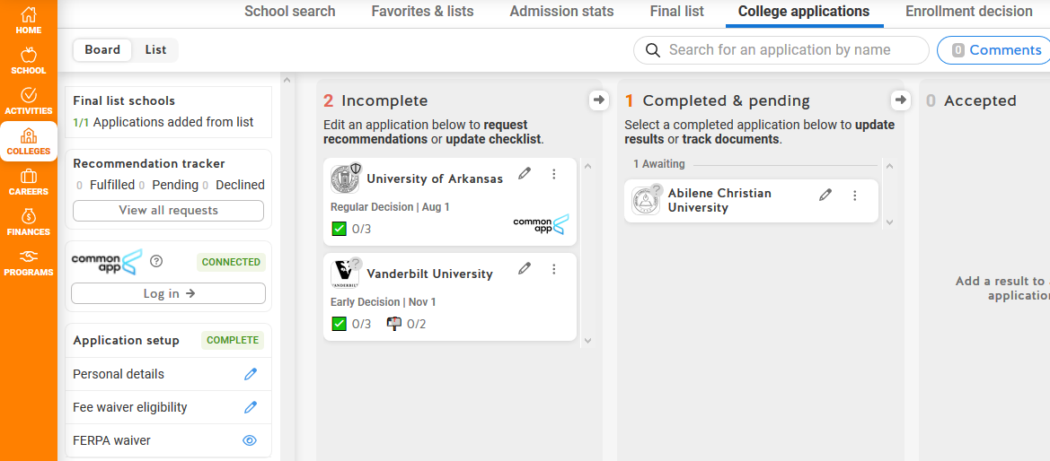

Slide 17
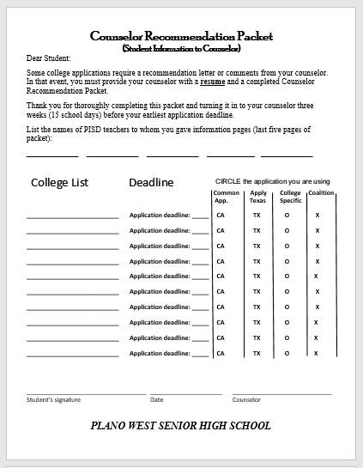
Counselor
Recommendation
If required by college
Give completed packet to your counselor 15 school days before
your earliest deadline
https://www.pisd.edu/domain/2498

Slide 20
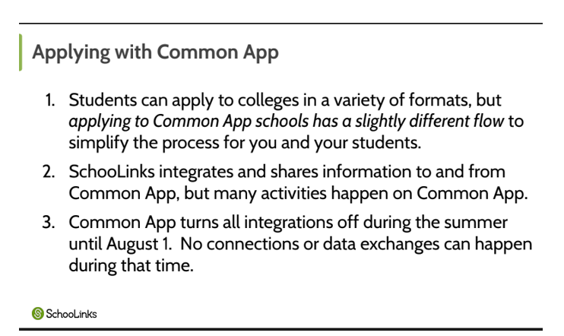

Slide 22
Requesting TEST scores

Slide 23
How to create
a
FINAL LIST

Slide 24
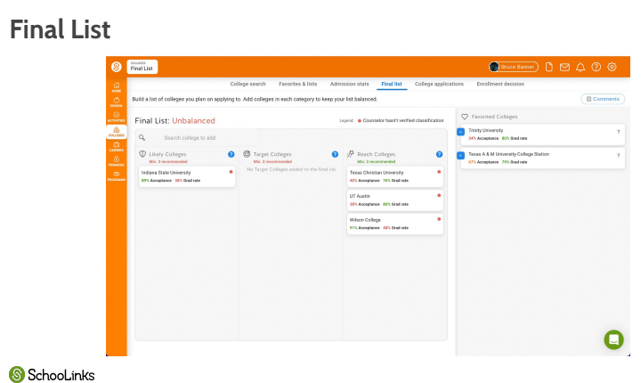

Slide 25
Where to locate resources
Plano West Counseling webpage
https://www.pisd.edu/Page/6304
Plano
West
Senior High School
https://www.pisd.edu/pwsh

Slide 26
Plano ISD College Night
Sept. 16, 2024 6pm - 8pm
Plano Events Center
Over 200 colleges and universities
Programs
FAFSA/TASFA Informational and Scholarship Informational

Slide 27
Upcoming Senior Webinar
Senior Webinar - Tuesday, Sept. 10th @ 6:30pm
“A Senior’s Roadmap to the Year Ahead”
Overwhelmed by the seemingly countless essays and applications? Unsure how to stand out and unclear on the timelines for financial aid, scholarships, and interviews? Ensure that you are on track for one of the most important years of your life.

Slide 28
Graduation is the Goal CLASS OF 2025
Wolf Pack

